Slide 1
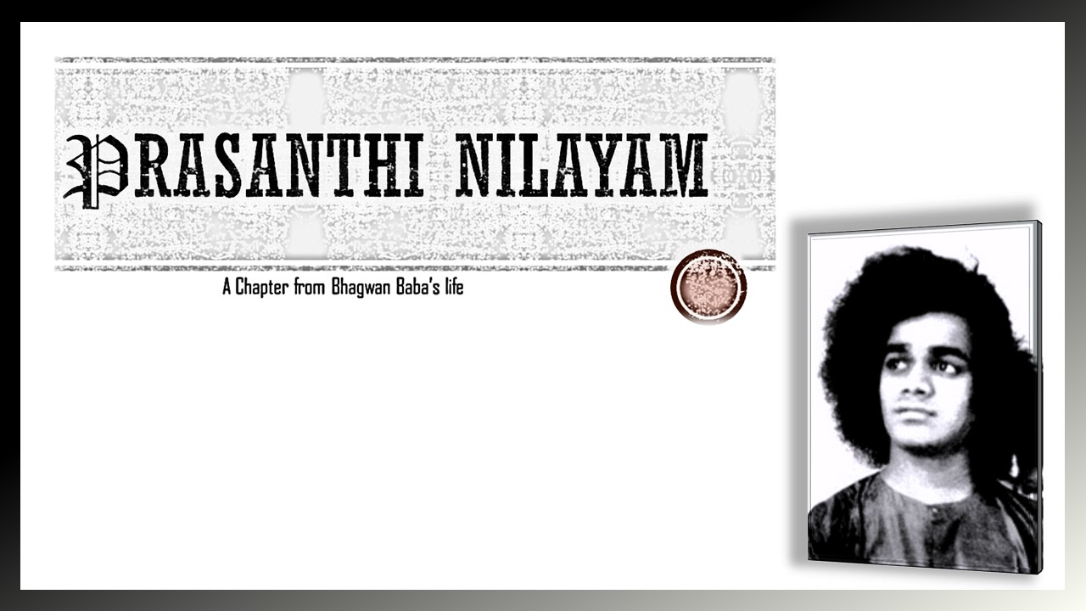
AN EXTRACT
FROM
SATHYAM SIVAM SUNDARAM

Slide 2
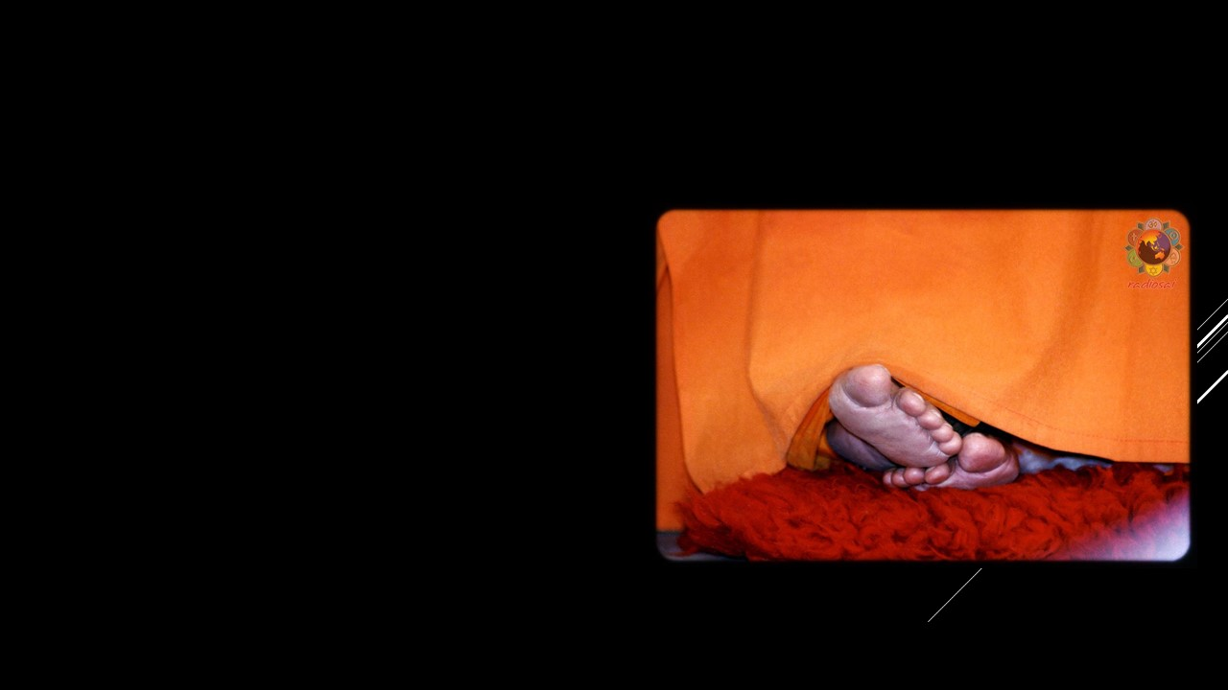
DEDICATED AT THE LOTUS FEET OF BHAGWAN BABA

Slide 3
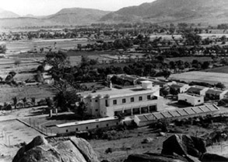
Prasanthi Nilayam was inaugurated on 23rd November 1950,
marking the 25th birthday of Baba

Slide 4
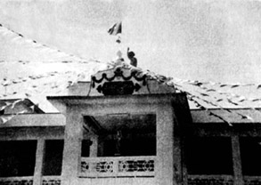
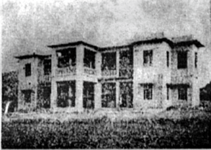
THE PRAYER HALL OF PRASANTHI NILAYAM AND IT’S SIGNIFICANCE
Three Gates of Prayer Hall
First gate, the Thamoguna Gate, the one with arch, signifies the removal of Thamas.
Second gate, containing aspects which are appealing to the Rajasic Individuals.
Third gate, the Sathwik Gate, leading us to the Abode of Peace.

Slide 5
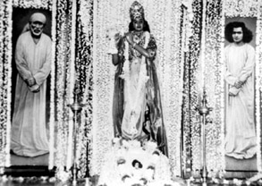
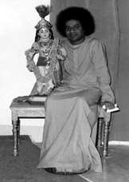
Prayer Hall
The Central Prayer Hall with a platform ensconced on either side is the main part of the Nilayam
On the western platform is the shrine, where two life size oil paintings of Shirdi Baba and Sathya Sai Baba are placed. Centre of that is a silver figure of Shirdi Sai Baba and small portrait of Sathya Sai Baba
There is big sized portico, where the charming marble image of Sai Krishna playing flute is placed in the centre. Swami on festivals would give his divine discourses from this portico

Slide 6
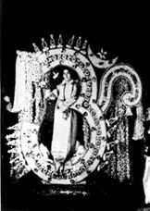
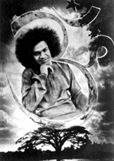
SIGNIFICANCE OF “AUM”
Letter “A”: Jagrat or waking state in which the soul of grade ‘Viswa’ is dominated by Thamas and is engaged with the Sthula Sarira
Letter “U”: Swapna or dreaming state in which the soul of grade ’Taijasa’ is dominated by Rajas and is engaged with the Sukshma Sarira. It also indicates ‘Ubhayathwa’ or intermediateness
Letter “M”: Sushupthi or deep sleep state finds the soul of grade of ‘Praajna’, dominated by Sathwa and it becomes the point mergence

Slide 7
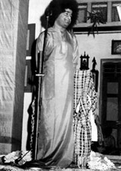
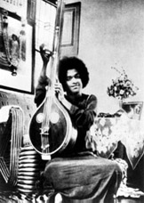
FESTIVALS
Dasara Celebrations
It starts with the flag hoisting and goes on with social work and followed by programs done by children
Then, there is a poet’s assembly and assembly and bhajans and Baba’s discourses.
The Dasara celebrations mark the victory over the evil

Slide 8
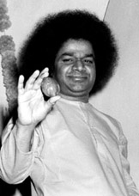
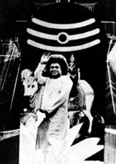
SIVARATRI CELEBRATIONS
Devotees perform all night vigil with bhajans in the immediate presence of Baba
Sivalingas have materialised within the Swami’s body ever since his avatar declaration
Swami used to undergo some some struggles until the lingams fell/came out from his mouth.
These lingams used to be placed on Shirdi Sai Baba’ photo and later were given to devotees
This occasion was celebrated as “lingodbhavam”

Slide 9
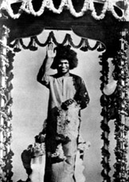
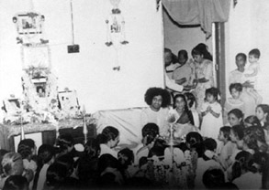
Other Festivals
Swami on Vaikunta Ekadsai, would distribute ‘AMRITA’ or divine nectar to people present there
He would emphasise on the importance of this festival and have some bhajan sessions
During the Varalakshmi Vratam festival, Swami use to grant the women his ‘Devirupam’ darshan.

Slide 10
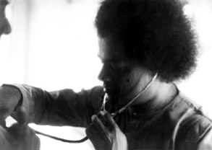
OTHER INSTANCES
Baba once at Gokhale hall, Madras corrected a devotee and said that the bhaktas can worship him from they are residing
He added that he will come to his bhaktas when called upon and not to make expenses which they can’t afford.
In 1957, a hospital was inaugurated with the facilities like and x-ray unit and equipment for surgery.
There were many miraculous recoveries with the blessings of Baba.
Also, sometimes he recommended the medical treatment himself and gave Vibhuti to ill people

Slide 11
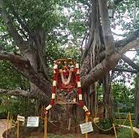
BODHI TREE
In the year 1959, during the month of April, Swami declared to plant the ‘Bodhi’ or banyan tree.
Swami took out a ‘Sansanas’ about 15 inches by 10 inches from the chitravathi sands
The banyan tree was planted on 29th june and Swami declared that yogis who have reached certain stage of tapas will automatically come to know of this tree and sansana

Slide 12
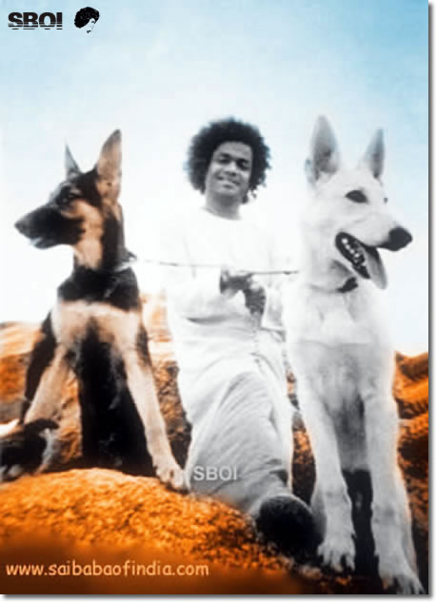
THE STORY OF JACK AND JILL
Jack and Jill were two Pomeranians from Oatacamud.
They fasted every Thursday, by some holy samskara of the past birth
They never consumed flesh
The story:
Jack and Jill had the privilege of three years ‘Sampiya’.
Jack was laying under a car which was parked across the river at Karnatanagepalli.

Slide 13
THE STORY OF JACK AND JILL
It was unknown to others that Jack was lying under the car. when the car started it nearly killed Jack.
He dragged himself to mandir and pulled himself on to the lap of Baba
Jack thus concluded his life. Jill couldn’t bear the separation and followed him in few weeks.
Both of them are buried in the centre of the quadrangle behind the ‘Old Mandir’, and a ‘Brindavan’ or ‘Tulsi structure’ has ben built over their mortal remains

Slide 14
QUIZ
When was Prasanthi Nilayam inaugurated? Which birthday of Swami did the inauguration mark?
The Sathwik Gate leads us to_____.
Whose paintings are present in the Prasanthi Prayer Hall?
What is the Significance of “AUM”?
What are the activities done during the Dasara festival?
What is Sivaratri festival famous for in Prasanthi Nilayam?
What did Baba insist to the devotees of Madras?
On which Auspicious day was the Bodhi tree planted?
What are the qualities of Jack and Jill?

